Slide 1










Retail Banking System Guided By : Ramanuj das Mentored by : jeyakumar kr

Slide 2


Team Members
Akshay Kumar LEADER
Prashant kumar
Member
Adarsh raj
Member
Chandra Mani Pandey
Member
Mihir Raj
Member

Slide 3
Roadmap
DESIGN
UNIT TESTING
E2E TESTING
1
3
5
2
4
6
CODING
AWS CLOUD DEPLOYMENT
PRESENTATION

Slide 4
AGENDA
INTRODUCATION & DESIGNS
1
MODULES
2
DEPLOYMENT
3

Slide 5



DESCRIPTION
This application aims to automate a portion of retail banking system.
This project covers JWT based Authentication,
Customer & Account creation, view account
statements,display customer details and transaction
services as well.
This application covers 4 microservices which is Authentication,Account,Customer,Rules & Transaction.
It also consists of client Angular application.

Slide 6

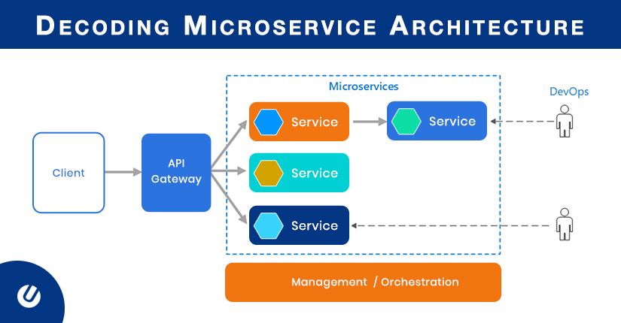
APPLICATION DESIGN

Slide 7


Authorization Microservice
It has two mapping, one for authentication & other one for validation.
The details of the user is passed to the authentication manager.
The user details service will load the data from H2 database.
JWT will next generate the token and then return it.
The token will be expired within stipulated amount of time after creation.

Slide 8
Account Microservice
For Creating an Account for a Customer
Fetching Accounts related to a Customer as a summary information
Fetching account statement for a particular customer based on a date range
Depositing to a customer’s account

Slide 9

Customer Microservice
For Creating a customer profile based on the details provided by the customer
Displaying customer’s profile

Slide 10
Rules Microservice
The Rules microservice will be responsible for interacting with a rules engine to evaluate certain rules that is applicable prior to performing transactions
Trigger – Invoked from Transaction service while performing a withdrawal or transfer, System generated event for applying service charges on accounts that do not comply with the min balance criteria. Invoked from a monthly running batch job

Slide 11


Transaction Microservice
The Transactions microservice will be responsible for performing all transactions within the Retail banking app like Deposits, Withdrawal, Transfers.
The service is responsible for checking business rules &propagating transaction contexts to Entities participating in the transaction.
This service in turn will invoke behavior on the Account service

Slide 12
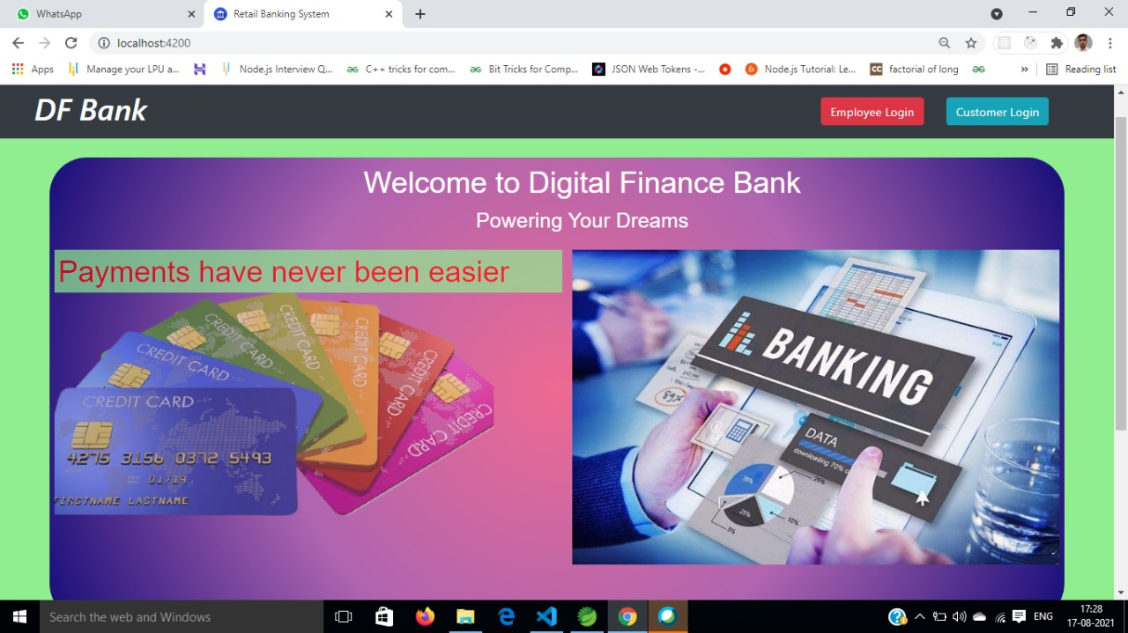
Retail Banking
Web Portal
This is the client based Angular application which allows members to login.
On successful login, it asks for customer/employee details.
Invokes the account & customer microservice to get the details.
Validates the data.
Displays processed transaction details.

Slide 13
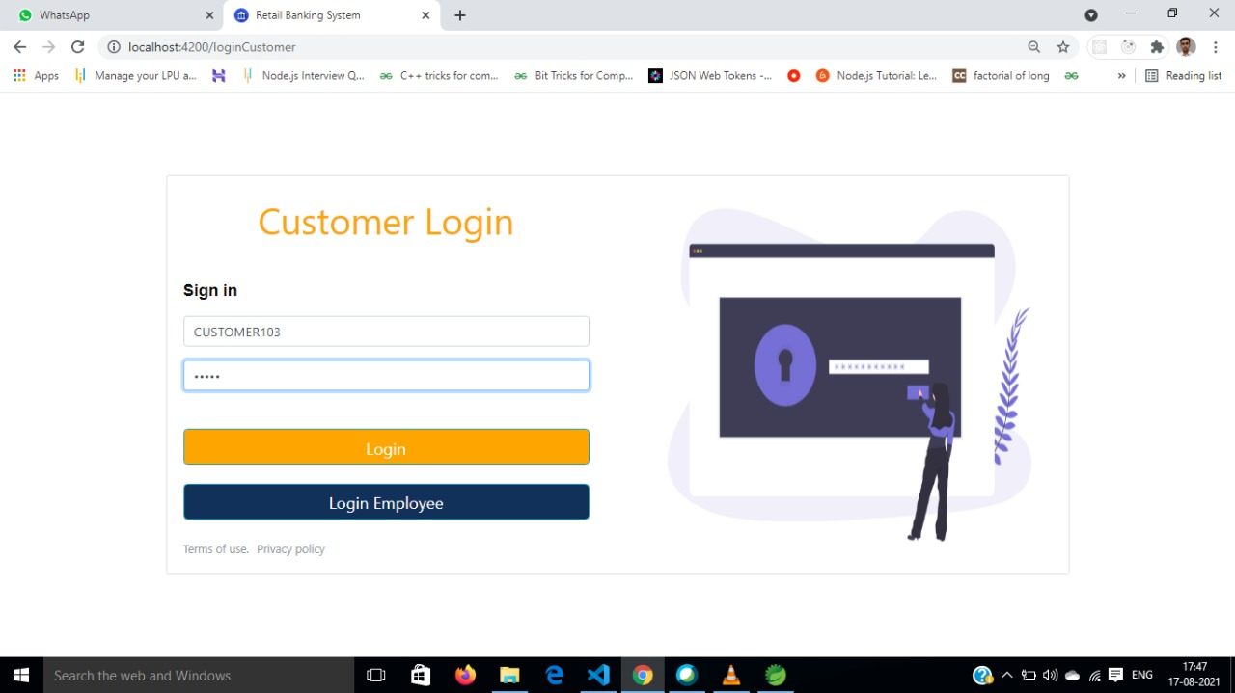

Slide 14
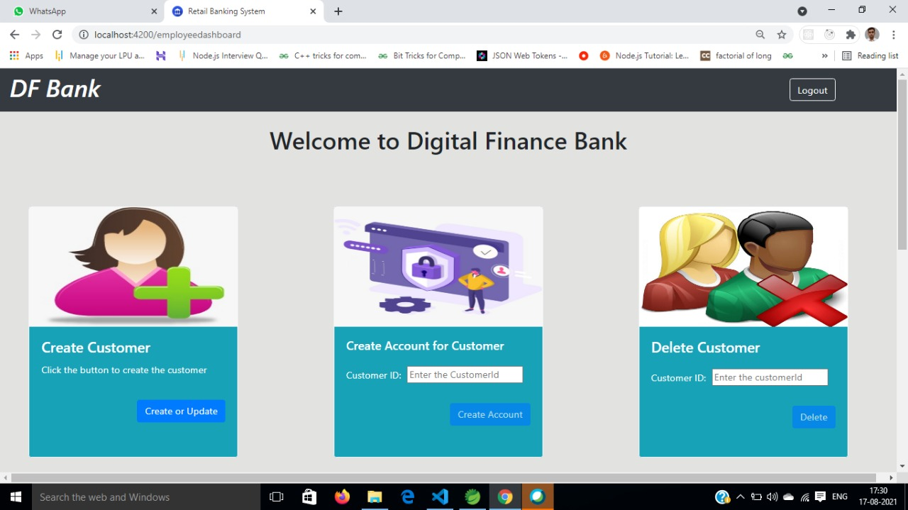

Slide 15
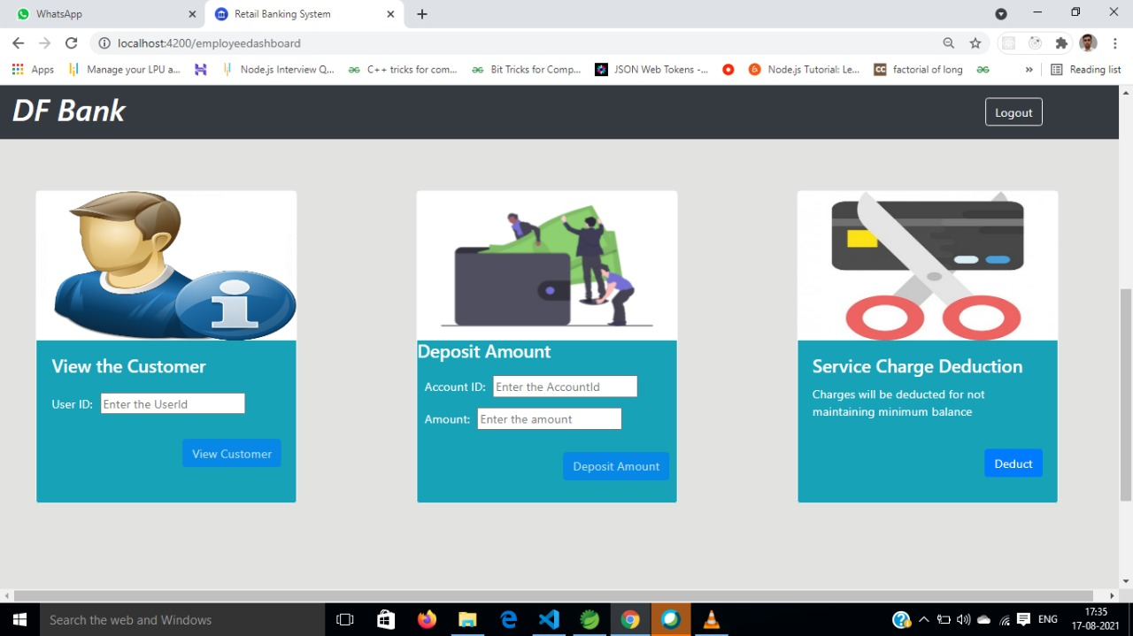

Slide 16
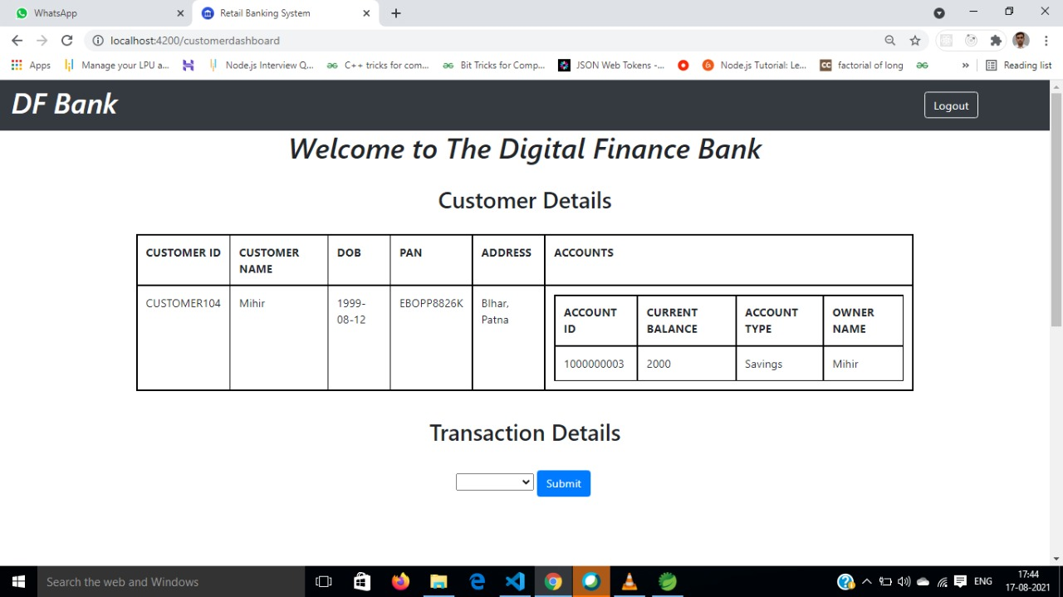

Slide 17
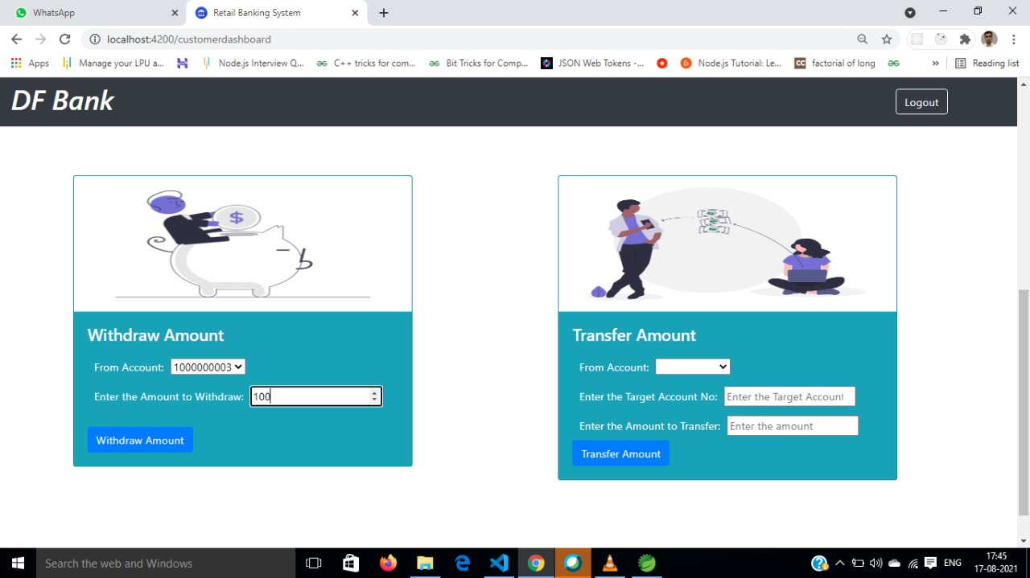

Slide 18
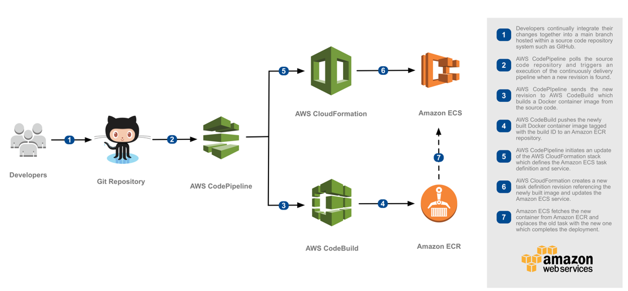
AWS DEPLOYMENT

Slide 19
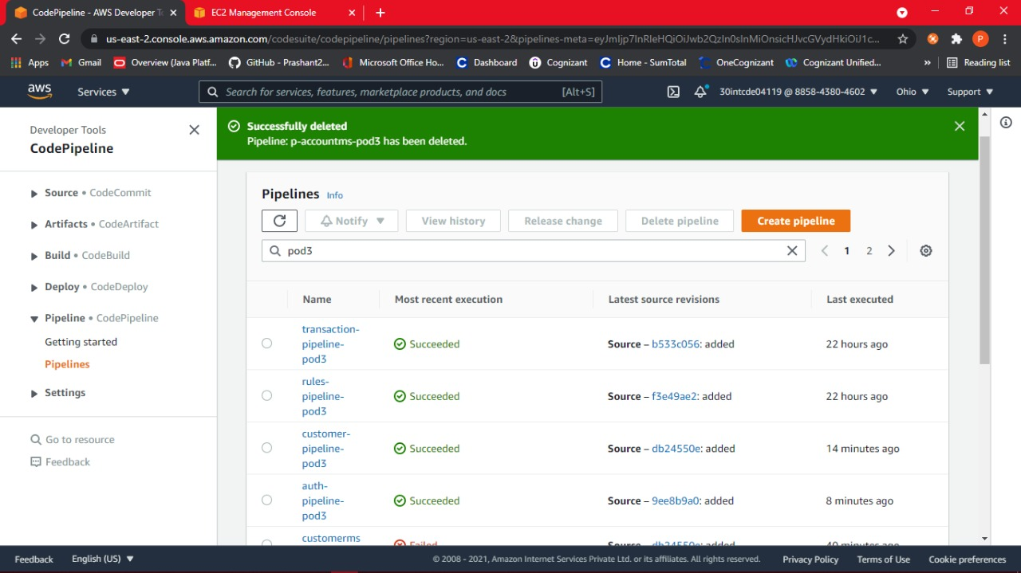

Slide 20
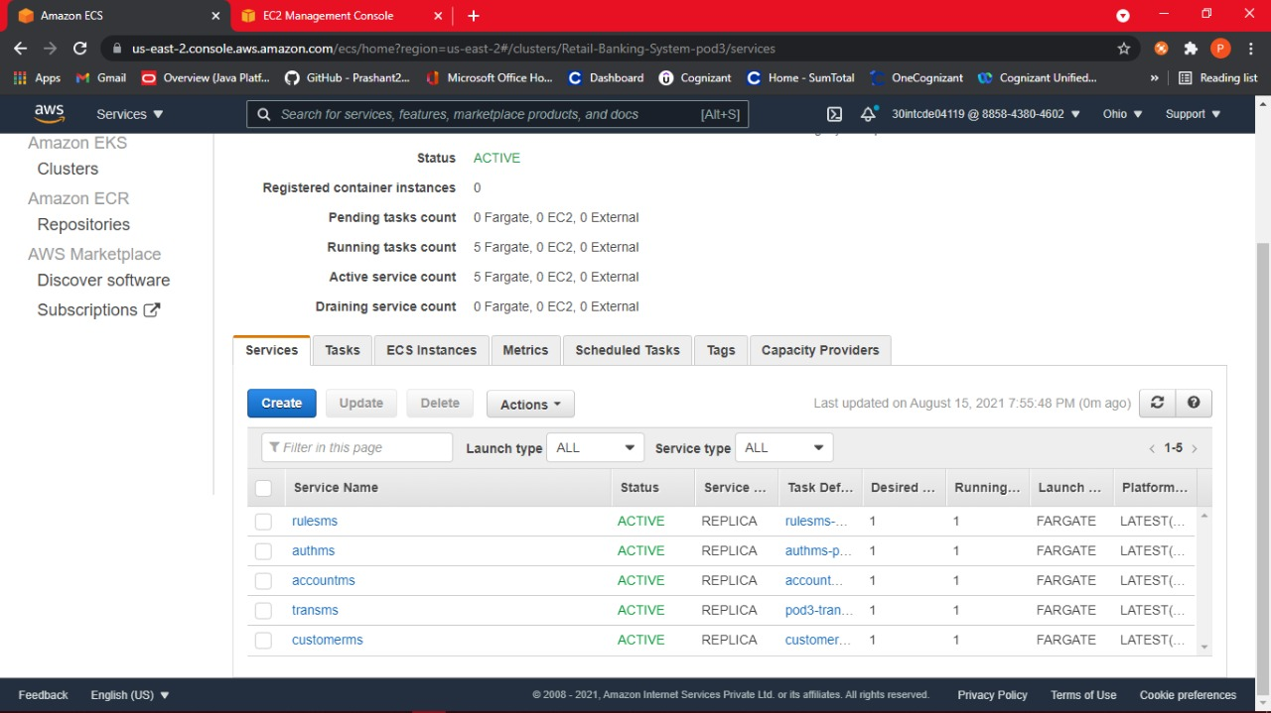

Slide 21
THANK YOU !

